Slide 1

Communications and Controls in IOT
Remotely Controlled Simple Pendulum
Team: RRR(Remote Realm Rangers)
Prof: Sachin Chauhdari
TA: Vedant Nipane

Slide 2
Introduction:
Through this presentation we will explain our CCIoT project of Simple Pendulum in which we aim to automate this process, by using IoT technologies actuate the simple pendulum motion and sense the value of instantaneous gravity and upload it on a dashboard to monitor it.
In this ppt, we will explain,
Problem Statement
Components Used
Our idea to change the length.
Actuation
Calculation of g-value:
How we stop the experiment
Our Dashboard

Slide 3
Problem statement:
All the schools cannot buy costly equipment for all the experiments that students require to do, So we are creating a service through IoT devices where we can place this experimental setups in a remote place and perform the experiment through IoT services like BYLNK or custom-made portals. We made one of the experimental setups to demonstrate how we can do that. In our project we made a remote-controlled simple pendulum.

Slide 4
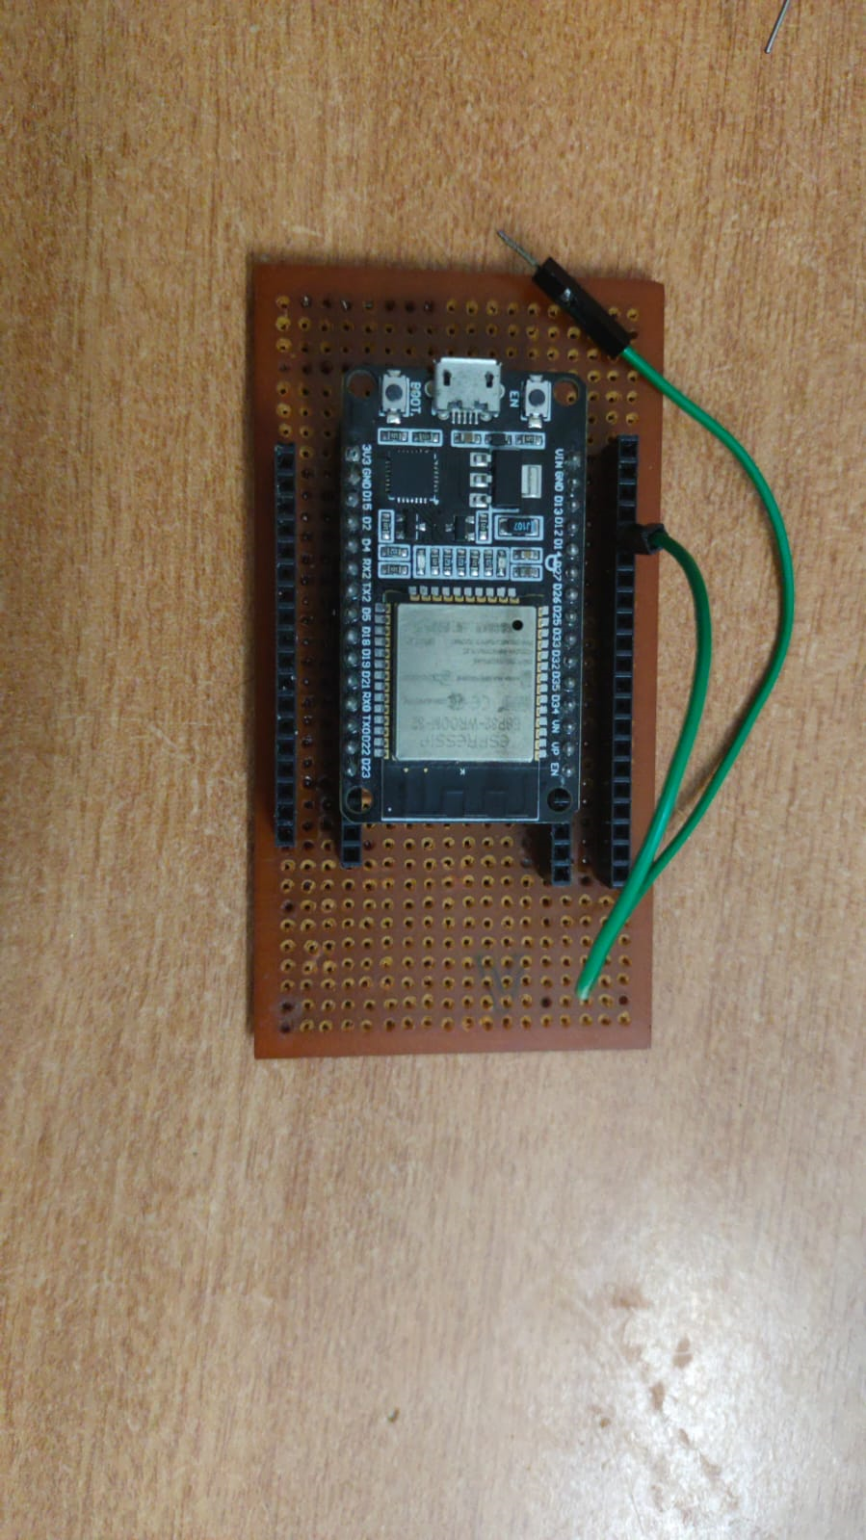
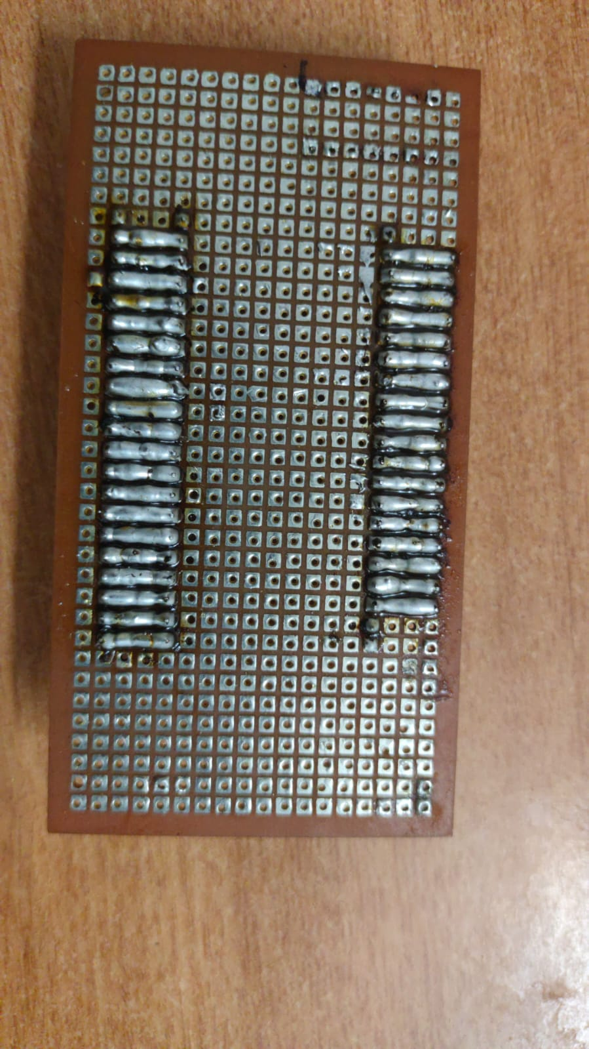
Components Used:
1) ESP-32:

Slide 5
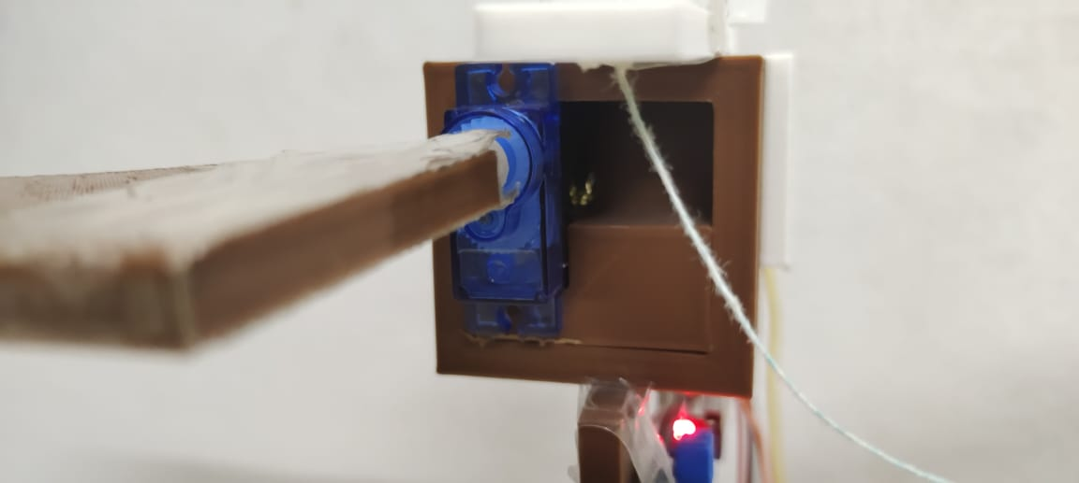
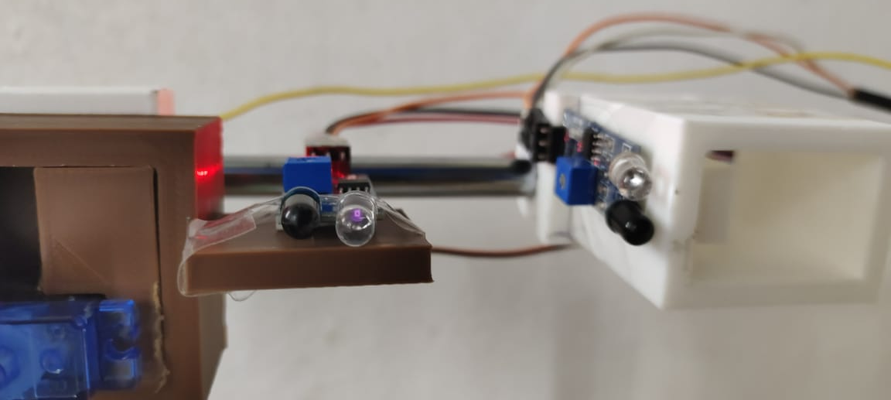
Components Used:
2) Servo Motor:
3) IR sensor:

Slide 6
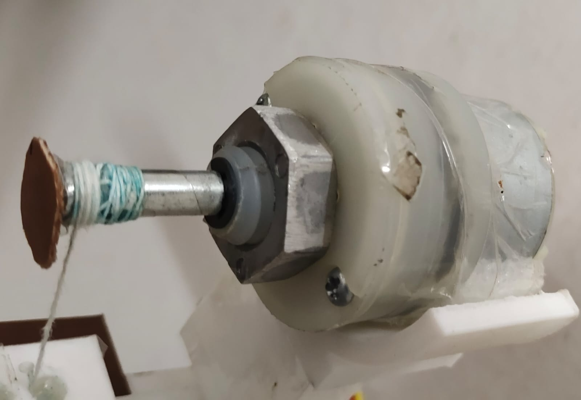
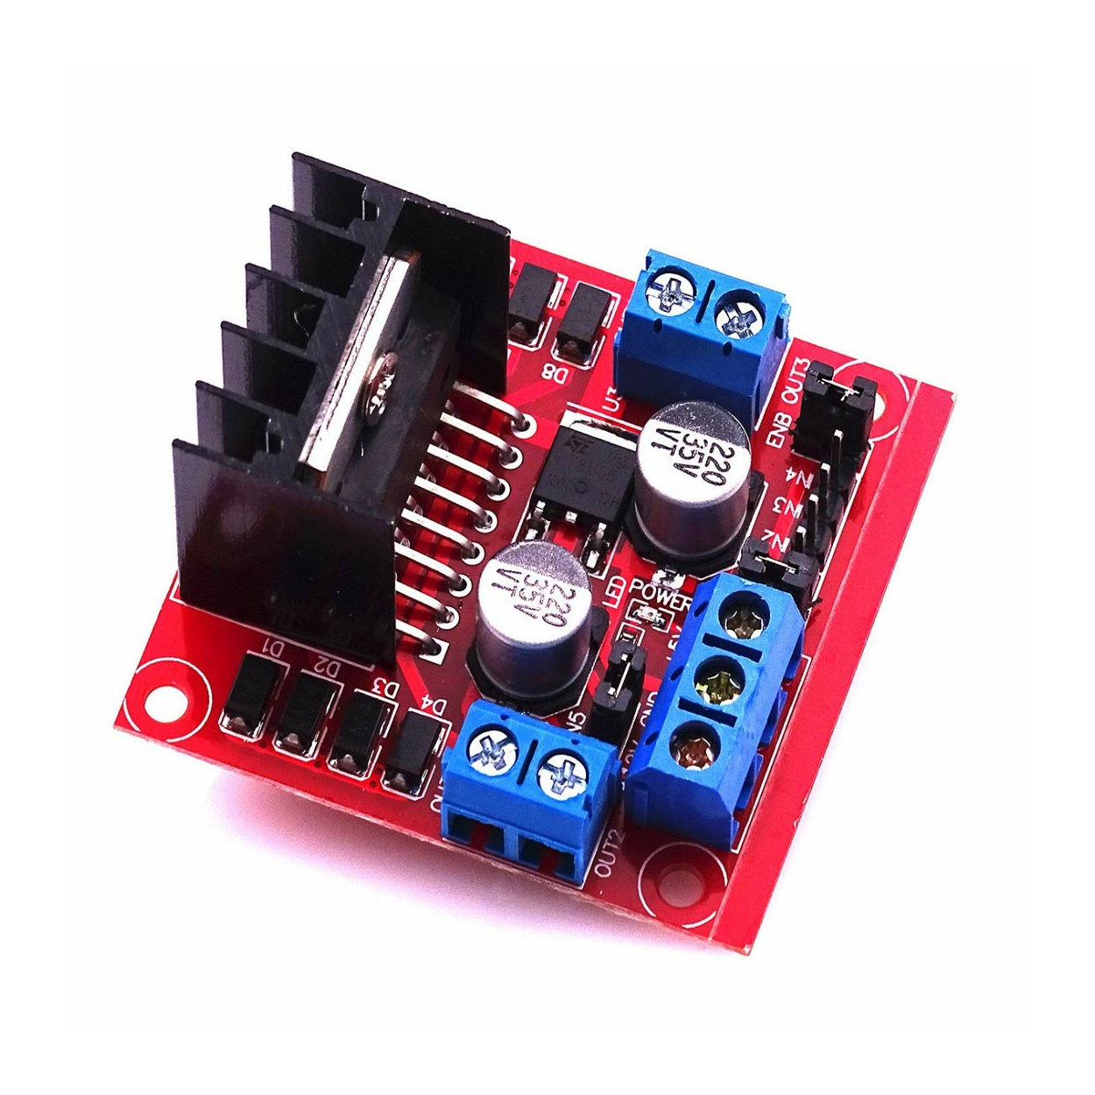
Components Used:
4) DC motor:
5) Motor Driver:

Slide 7
Changing the Length:
We change the length of the simple pendulum using a DC motor connected through the motor driver. In order to change the length, we first have to make sure to stop the experiment from the dashboard, this will bring the bob back to its minimum length i.e. 10 cm and we calculate the difference between the new length input through the dashboard and the minimum Length and we calculate the time our DC motor should run as its speed is set by us, in this it is 6.9 cm/s which we got using setting the proper duty cycle input to the motor driver and verifying the length extended in a particular time.

Slide 8
Actuation:
We give a push to the string to which the bob is connected in a vertical plane by using a flap connected to a servo motor
. This works as whenever we initiate the experiment using the dashboard, the bob first goes to the new length and the servo motor rotates it flap to give a push to the pendulum and initiate its oscillatory motion.

Slide 9
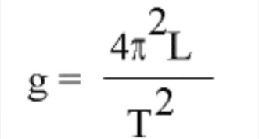
Calculation of instantaneous-g value:
Our main aim through this project was to calculate the instantaneous acceleration due to gravity values.
For this, we are using an IR sensor that is calibrated to detect the string to which the bob is connected.
We calculate the Time difference between 2 consecutive times the bob passes through the mean position.
We use this time to calculate the instantaneous g value by using the formula,

Slide 10
Stopping the Experiment:
After performing the experiment for some time, we need to reset the length of pendulum to minimum value so that we can initiate the experiment for another length.
For this, we need to stop the experiment and send back the bob to minimum length.
For this, we our using another IR sensor whose range is calibrated to be just till the end point of the bob i.e., it can only detect the bob and not the string. The IR sensor is placed at the minimum length i.e., 10 cm and whenever we stop the experiment the DC motor starts rotating the string to decrease the length of the thread and once the bob is detected by the IR sensor
Once the bob is detected, the DC motor is stopped, and the bob is placed at the minimum length and the experiment stops until we initiate the experiment again from the Dashboard.

Slide 11
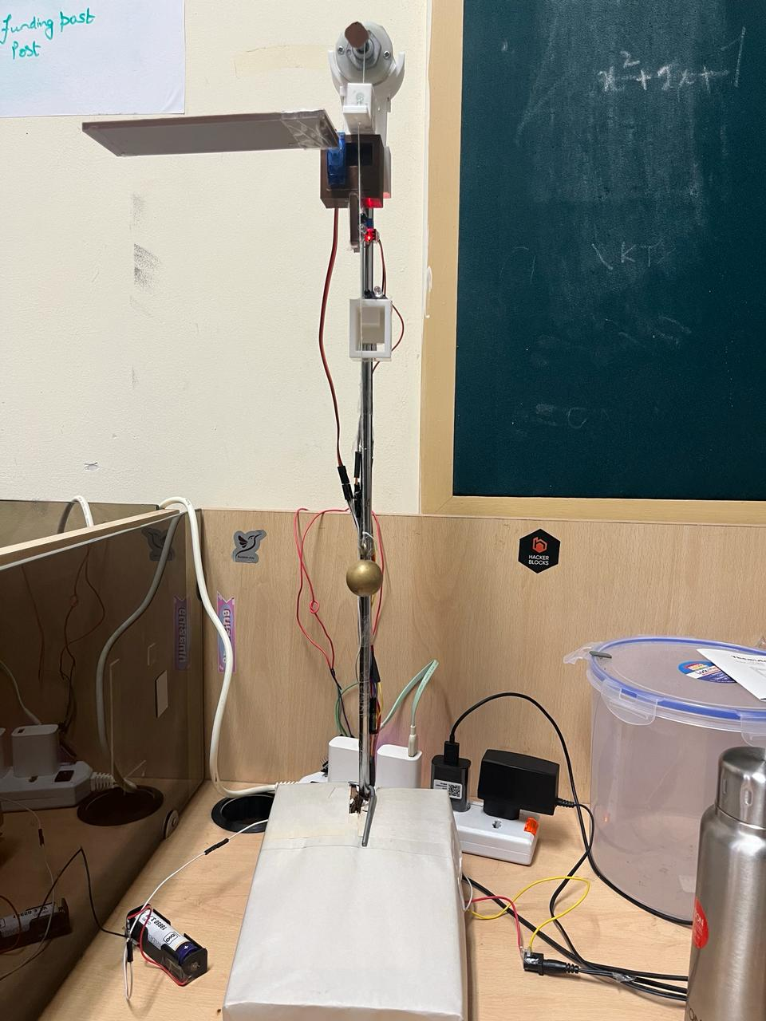
Final setup for our project:

Slide 12
Dashboard:
BYLNK:
We use this Web Server to remotely control the simple pendulum.
The Length, start of experiment and stop of experiment are input through the dashboard of this server.
We display the values of Time Period and Instantaneous Acceleration due to gravity on the dashboard.
Thing Speak:
It is used to store the values.
We can use the stored data for further analysis of data
We are sending the values of Time period, Instantaneous Acceleration Due to gravity and Length of the pendulum into Thing speak Server
We can extract data from the server and plot average values of acceleration, Quartile Range, t v/s sqrt(l) , etc... using some programming language to verify our results

Slide 13
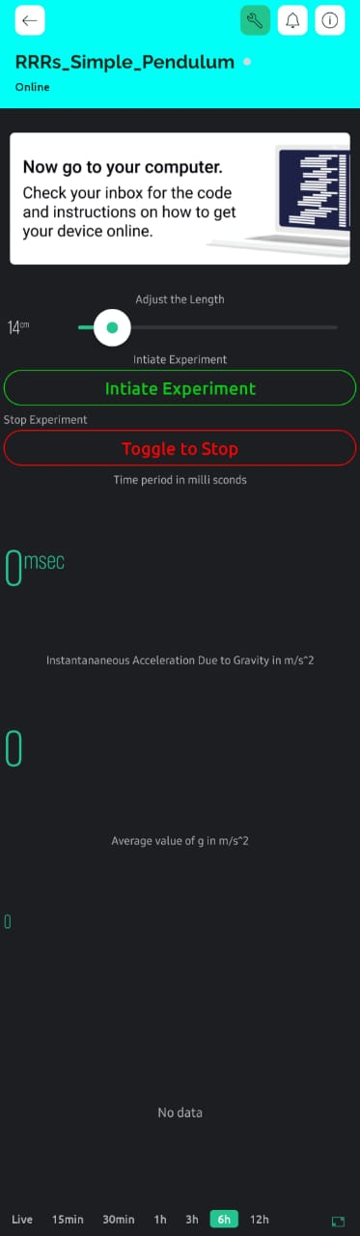
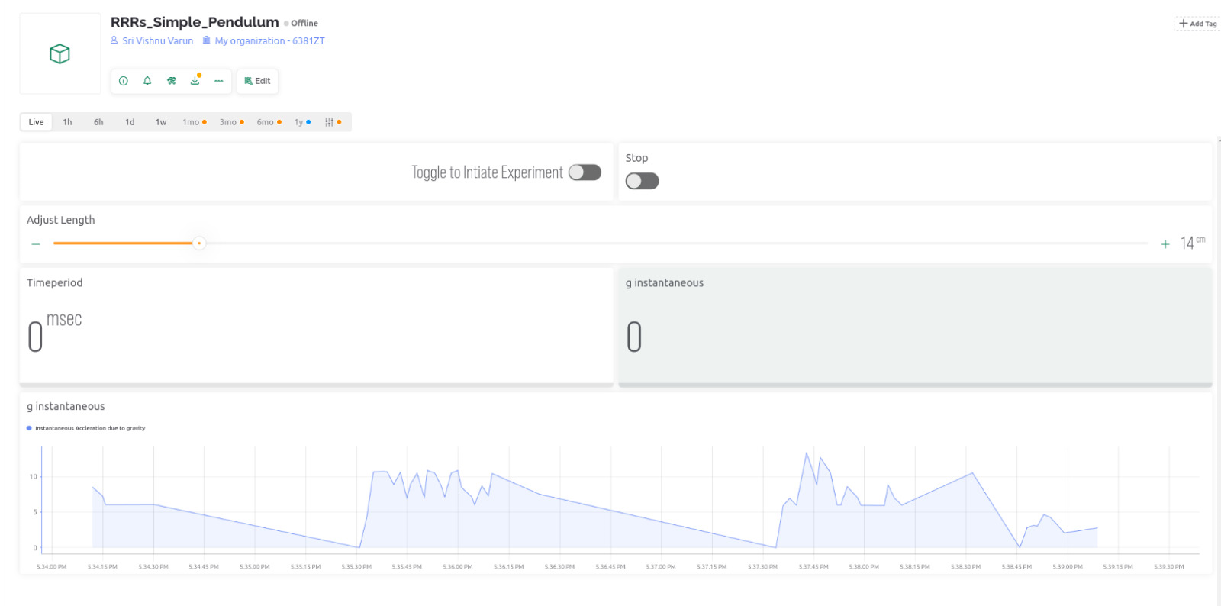
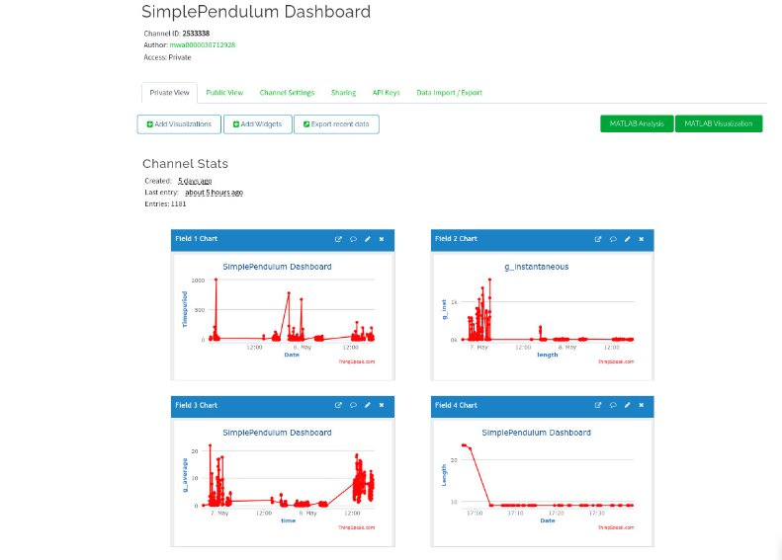
Dashboard:
Blynk Mobile Dashboard
Blynk Web Dashboard
Thing Speak Dashboard

Slide 14
Procedure
Set the length using slider on the dashboard
Press start to move to the new length and actuate the motion of the pendulum
IR senses the motion to count the time elapsed between its alternate detections which turns out to be the time-period of the pendulum oscillation
Using the formula, we calculate the value of g and send both the values to Blynk server and display it on the dashboard
Finally Press the Stop button to bring back the bob to minimum length and damp the oscillations
Repeat the process to perform the experiment again
Note that the experiment must be stopped before starting the new one to adjust the lengths properly
Here is the Link to Demonstration of the project: Project Demo

Slide 15
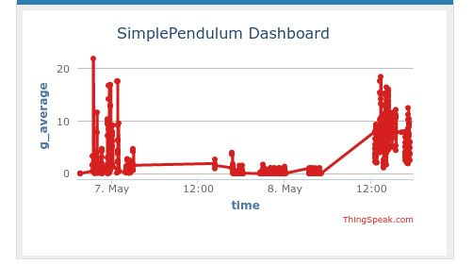
Analysis:
g_avg vs Time plot:

Slide 16
Problems Faced
Motor was not able to lift the bob upwards to proper length.
So, we used an IR to bring it back to minimum length and then actuate it for given input length
We faced a lot of problems due to calibration of IR sensor.
We used a case to obstruct the external light falling on it
The stand was not stable so had some wrong values.
Accidental touches on the slider may change the length of the pendulum
We will change the length of the bob only when start button is pressed
Jittering of the IR sensor due to load on ESP because of using same pins for VDD and GND (insufficient power)
Attach and detach the servo motor using inbuilt functions
Put the IR sensors to sleep when not in use i.e., Use GPIO pins to give VDD and GND to the sensors and put the VDD to LOW whenever the sensors are not required

Slide 17
Conclusion:
In summary, our project successfully constructed a basic pendulum integrated with IoT, allowing real-time monitoring of Acceleration due to gravity values. This merger of traditional physics experimentation with modern technology enabled enhanced data collection, analysis, and remote accessibility.
By seamlessly integrating sensors and connectivity solutions, we expanded our understanding of pendulum dynamics while showcasing the potential of IoT in scientific research and education.

Slide 18
Thank You...!!!
Team members:
K Sri Rama Rathan Reddy (2022102072)
J Dhanush (2022102006)
T Sri Vishnu Varun (2022102031)
Aditya Raj Singh (2022102067)

